Slide 1

Case Study: Intelligent Systems (WS25/26)
Predictive Maintenance of Milling Machines
Lecturer: Hamidreza Heidari
Members: Irtaza Janjua, Soman Tariq, Sadeed Ahmad, Usama Ali

Slide 2
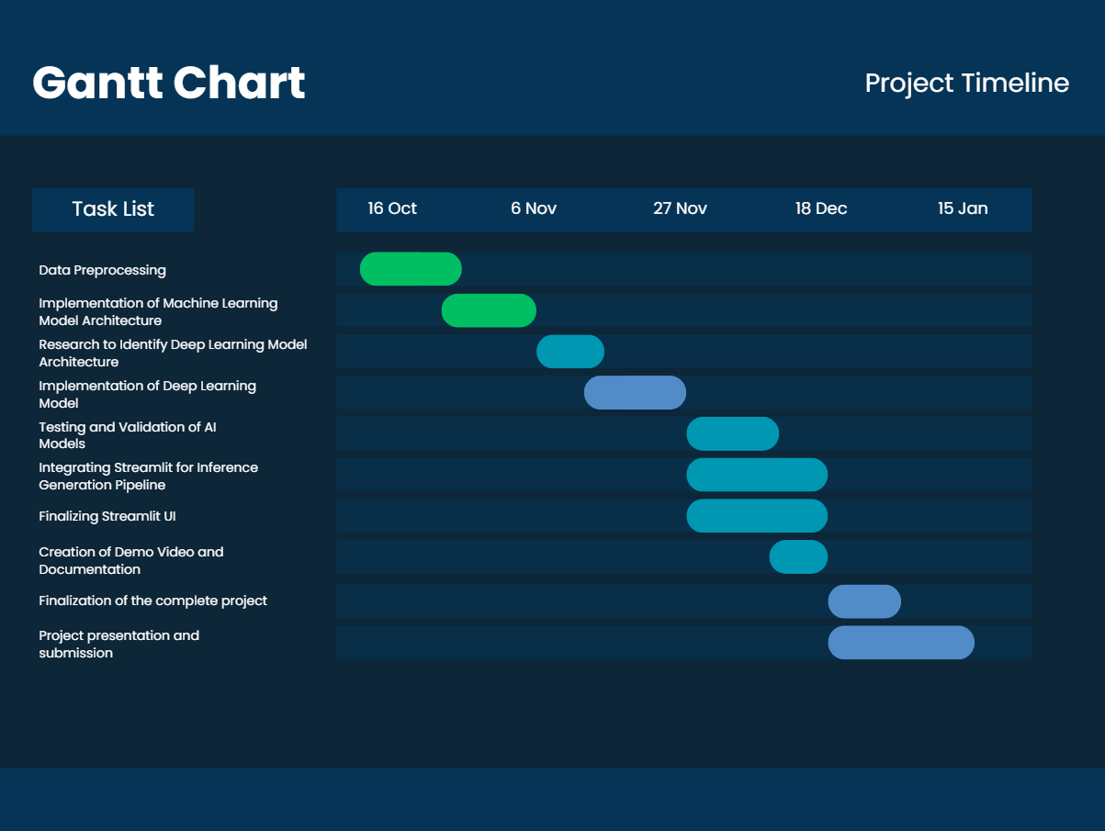
Project Timeline

Slide 3
Industrial Application
Unplanned failures are rare but costly, triggering downtime, scrap, rush repairs, and throughput loss across lines.
Industry 4.0 generates dense sensor streams (temp, torque, speed, wear), making data‑driven maintenance both possible and necessary.
Condition‑based AI PdM target predictions of concrete failure modes to cut downtime and maintenance spend.
Engineering trust is enabled by interpretable signals (e.g., tool‑wear dominance for TWF; power/temperature patterns for PWF/HDF).

Slide 4
Prior Work & Project Objectives
Prior work: supervised ML with Random Forest, SVM, XGBoost;
RF is a strong, interpretable PdM baseline with emphasis on preprocessing and feature relevance.
Evidence: explainable PdM on the same synthetic dataset shows RF robustness and clarity for industrial use.
Gap: classical baselines underfit complex interactions and overlapping modes;
Deep learning approaches report stronger robustness and accuracy.
Our approach: deploy an ensemble of deep learning models to surpass current RF metrics while retaining interpretability and production readiness.

Slide 5
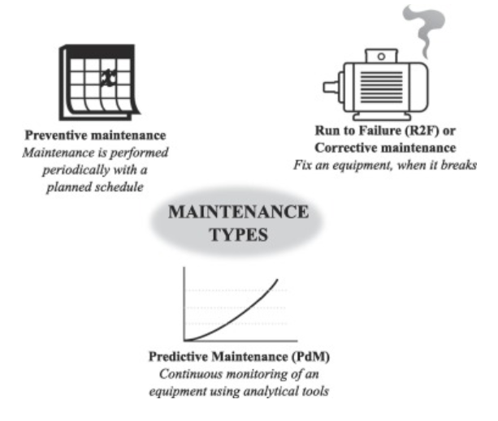
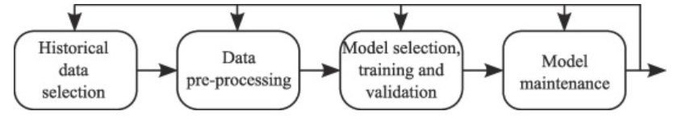
Literature Overview & Key Methodologies
[1] Carvalho et al., 2019 Systematic Review of ML in PdM
Compared maintenance techniques.
Compared ML techniques for fault detection and RUL prediction.
Highlighted Random Forest, SVM, and Neural Networks as top-performing models.
Emphasized importance of data preprocessing and feature relevance.
Fig. 2. Design of a ML model for PdM application
Fig. 1. Types of Maintenance

Slide 6
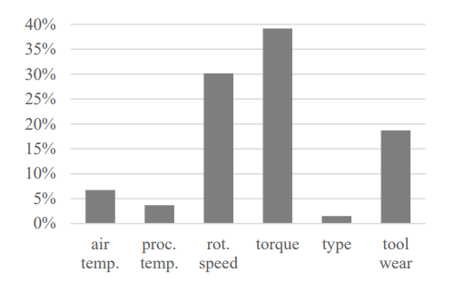
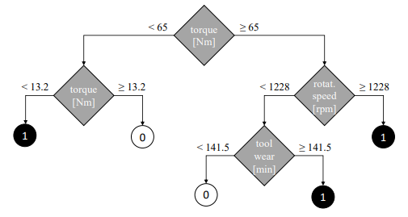
Literature Overview & Key Methodologies
[2] Matzka, 2020 Explainable AI for PdM
Synthetic Dataset implemented in our study. (10,000 samples)
Showed Random Forests’ interpretability and robustness in industrial data.
Stressed feature transparency for maintenance engineers.
Fig. 3. Decision Tree; A result of 0 represents normal operation, whereas a result of 1 represents a machine failure.
Fig. 4. Estimated relative predictor importance of the features used in the complex decision tree

Slide 7
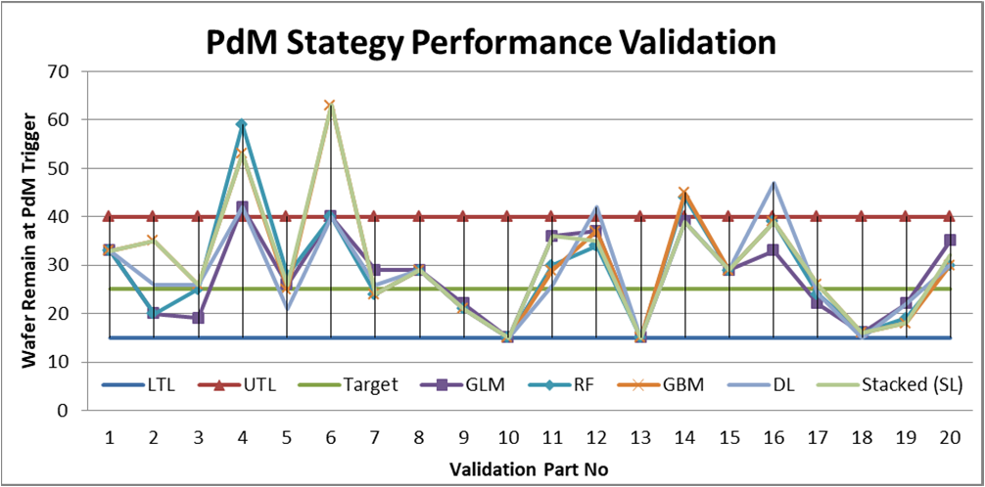
Literature Overview & Key Methodologies
[3] Sujata Butte, Prashanth A. R., and Sainath Patil, 2018 — Machine learning based predictive maintenance strategy: a super learning approach with deep neural networks. IEEE, 2018
Proposed a deep learning framework combining deep neural networks with other ML models for predictive maintenance.
Demonstrated improved robustness and accuracy in predicting equipment failures using manufacturing data.
Highlighted the practical benefits of deep learning for PdM systems, enabling easier automation and adaptability in dynamic production environments.

Slide 8

Key Takeaways
Random Forest remains a strong baseline for early-stage PdM studies.
Data quality and preprocessing are critical to correct model implementation.
Deep learning approaches to be explored in next stages.

Slide 9
Key Takeaways
Random Forest remains a strong baseline for early-stage PdM studies.
Data quality and preprocessing are critical to correct model implementation.
Deep learning approaches to be explored in next stages.

Slide 10




Tech Stack & Methodology Overview
Dataset: AI4I 2020 Predictive Maintenance (UCI)
Tools:

Slide 11
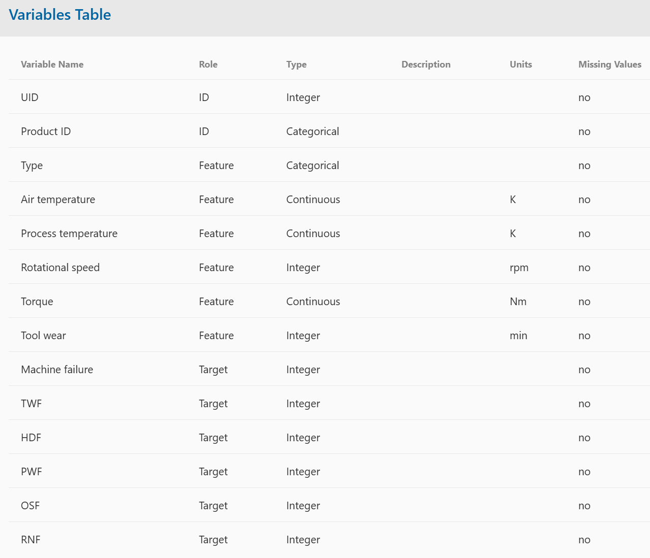
Data Understanding
10,000 samples (unique IDs).
Type: Quality categories — Low (50%), Medium (30%), High (20%).
Air Temperature (K)
Process Temperature (K)
Rotational Speed (rpm)
Torque (Nm)
Tool Wear (min)
Targets:
Target 1: Machine Failure (Yes/No)
Target 2: Failure Type (categorical)
Tool wear failure (TWF)
Heat dissipation failure (HDF)
Power failure (PWF)
Overstrain failure (OSF)
Random failures (RNF)

Slide 12
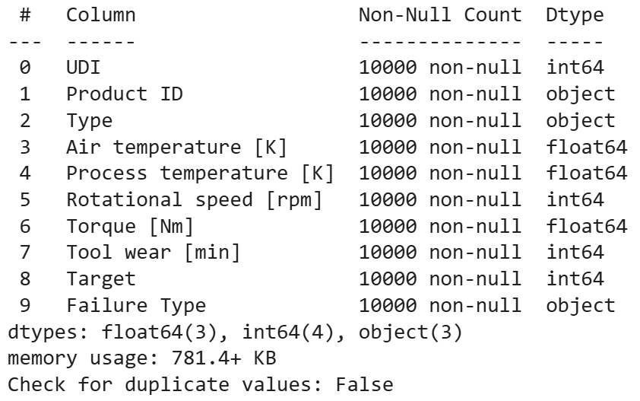
Initial Data Exploration
Checked for missing values → none found.
Checked for duplicates → none found.
Identified 6 numeric and 3 categorical features.
Converted numeric columns to float type for consistency.
Removed UDI and Product ID

Slide 13
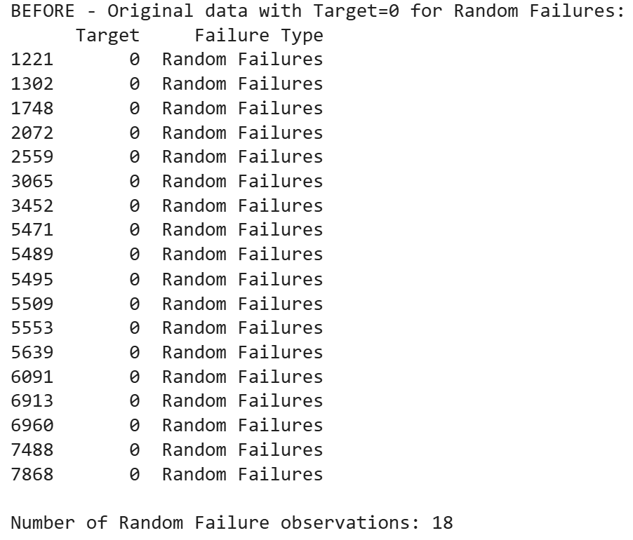
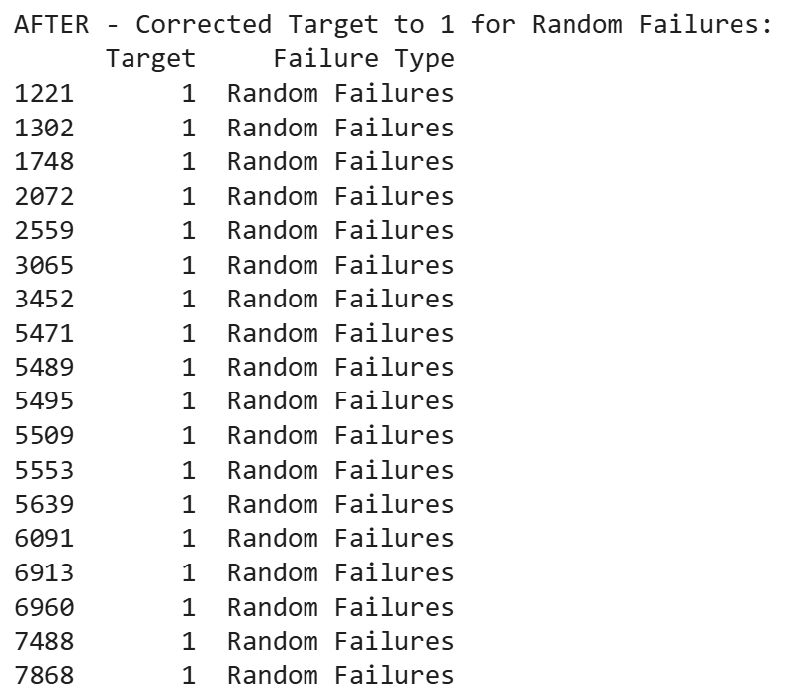
Target Cleaning and Correction
Found labeling inconsistencies:
Random Failures (RNF) were not marked as machine failures.
Corrected target values to set Target = 1 for RNF.
Removed ambiguous records (9 rows) where Machine failure = 1 but no specific failure cause was given.

Slide 14
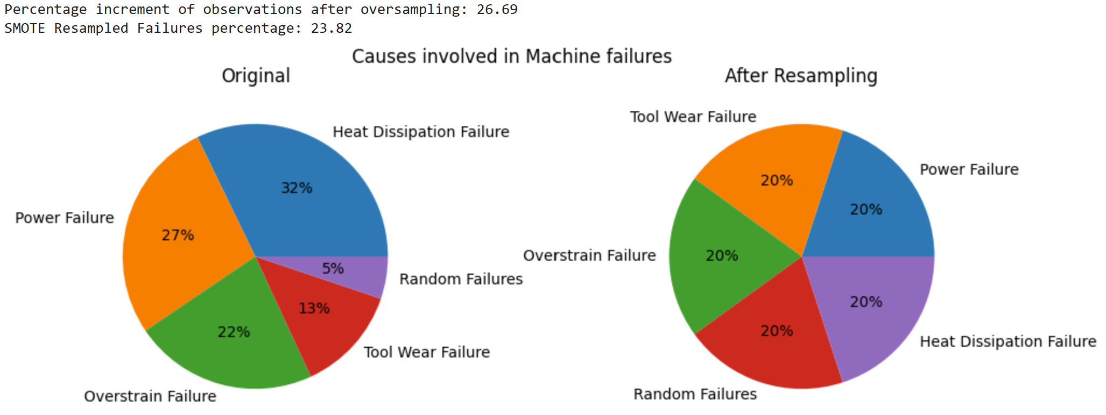
Handling Class Imbalance (SMOTE)
Only 3.57% of observations were machine failures.
Applied SMOTE (Synthetic Minority Oversampling Technique):
Generated synthetic samples for minority failure modes.
Balanced data to ~75:25 ratio (working:failure).
Achieved uniform representation across all failure types.

Slide 15
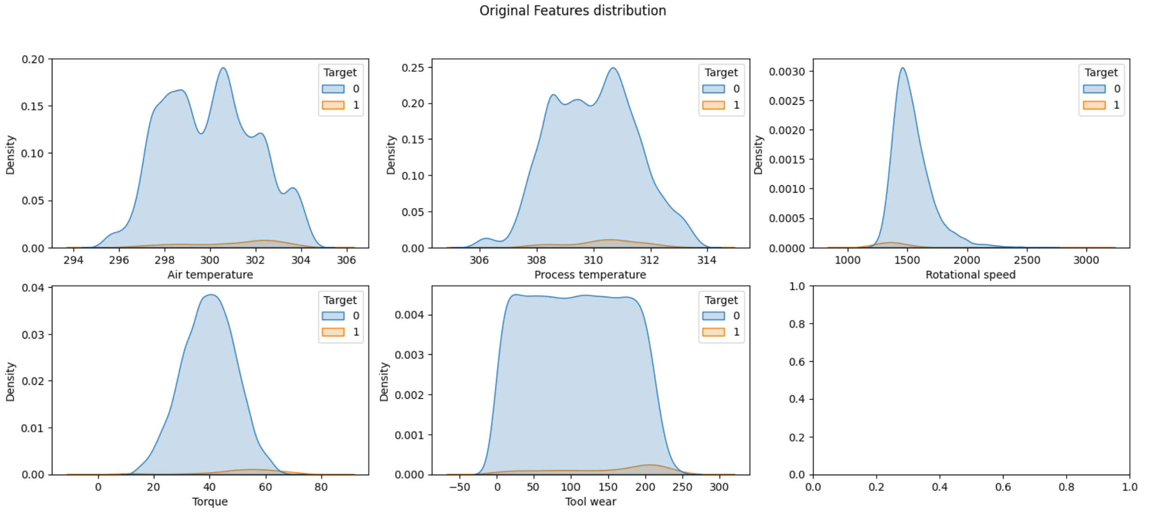
Feature Distribution before applying SMOTE

Slide 16
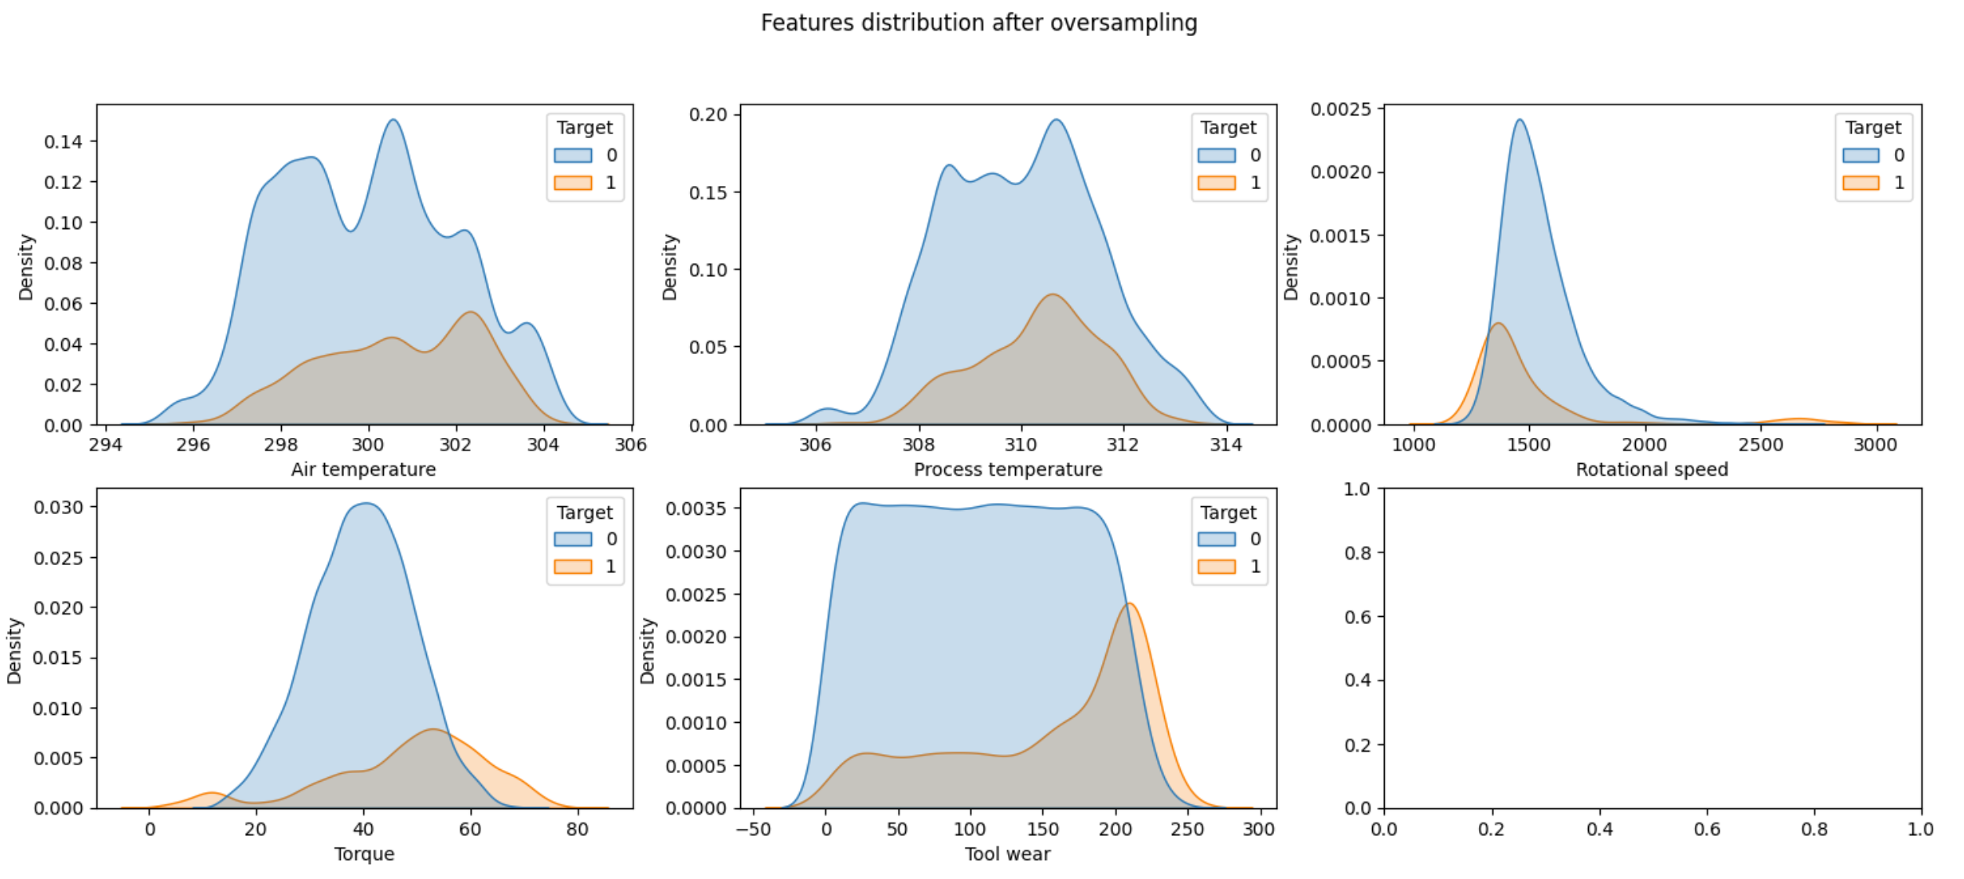
Feature Distribution after applying SMOTE​

Slide 17
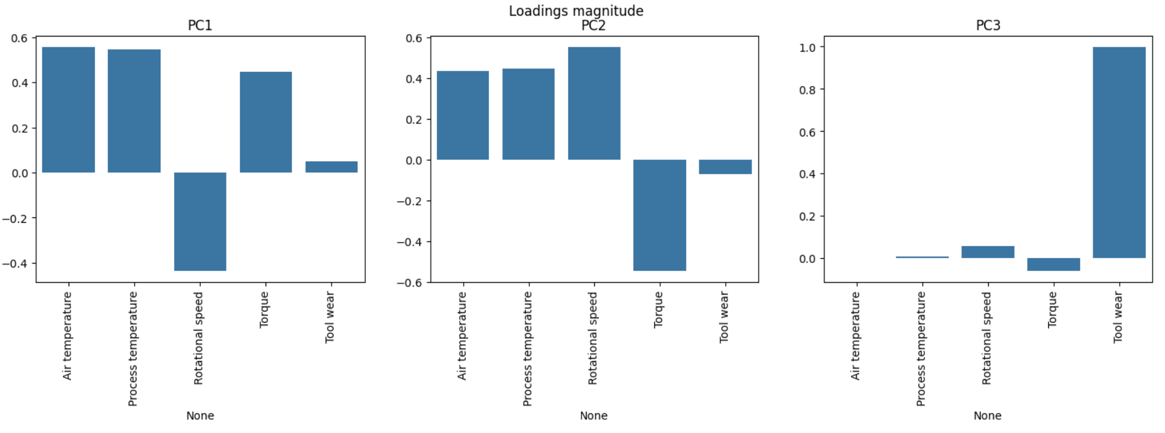
Principal Component Analysis
Applied Principal Component Analysis (PCA) on numeric features.
Top 3 PCs explain most of the variance.
Interpretation:
PC1 → closely related to the two temperature features
PC2 → can be identified with the machine power, which is the product of Rotational Speed and Torque
PC3 → Tool Wear

Slide 18
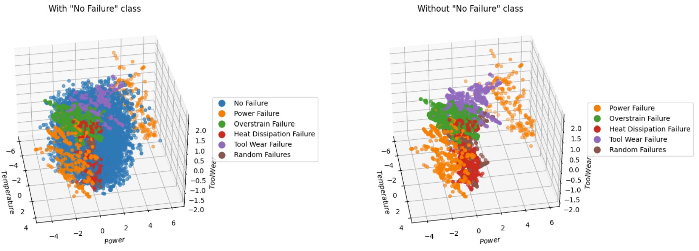
Data in 3D PCA space
TWF is the class of failures best separated from all the others and seems to depend almost entirely on PC3 (Tool Wear)
PWF occupies two extreme bands along the PC2 (Power), it is independent of the other two components
The OSF and HDF classes are less separated than the others even if it can be observed that the first is characterized by a high Tool Wear and low power while the second is characterized by a high temperature and a low power.

Slide 19
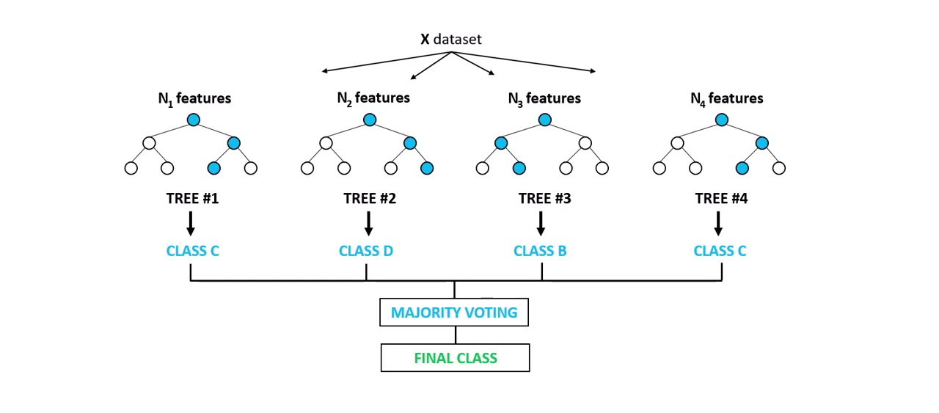
Model Choice: Random Forest
Most widely used and recommended ML model in predictive maintenance
Handles non-linear relationships and feature interactions very effectively
Naturally robust to noise and outliers
Less sensitive to class imbalance compared to models like SVM or logistic regression
High interpretability through feature importance and tree-based explanations

Slide 20
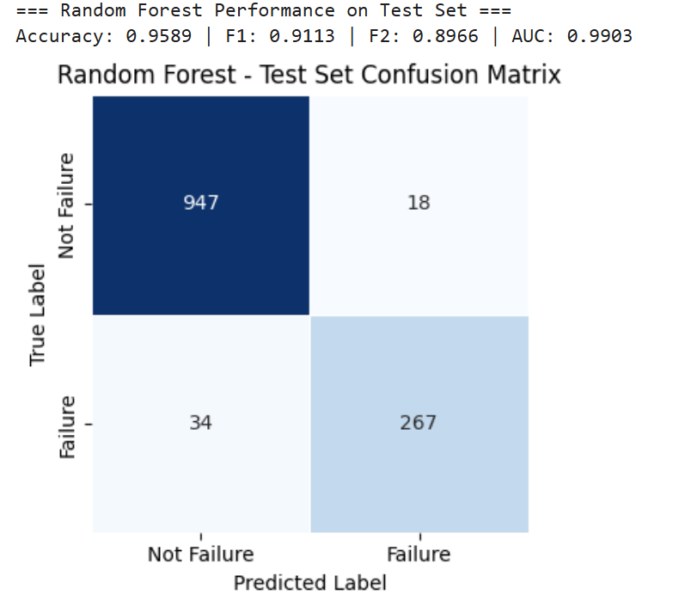
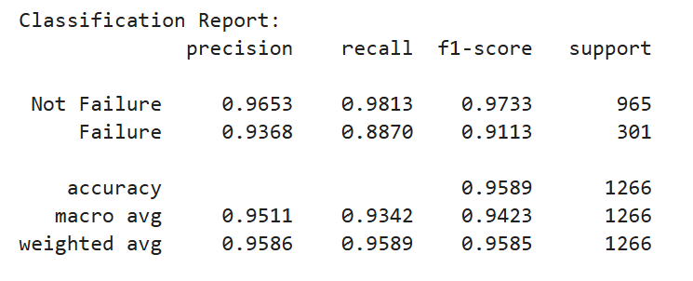
Random Forest Results

Slide 21
Future Work
Implement Deep Learning models
Compare performance vs. Random Forest using balanced metrics
Deploy best-performing model using Streamlit for an interactive PdM dashboard
Integrate real-time inference pipeline

